Slide 1
Lightweight MapReduce for shared memory systems
Matthew Canham, Nick Pollett, James Tizard

Slide 2
Questions we will answer
Why should we use MapReduce?
What MapReduce is and how it works?
What are some popular implementations of MapReduce?
What will our solution for optimising MapReduce on a shared memory system will look like and what we have running currently?
What work is left to be done?

Slide 3


Motivation
word.io

Slide 4
Motivation
MapReduce is a well-known approach in distributed systems to execute large data processing tasks in parallel.
MapReduce enables programmers to write distributed applications without having to worry about the underlying distributed computing infrastructure.
MapReduce provides the ability to transparently scale out the cluster by adding nodes. The automatic failover of both data storage and data processing subsystems happen with zero impact on applications.
It is useful in a wide range of applications including at Google, to completely regenerate Google's index of the World Wide Web.

Slide 5
How does MapReduce work?
1. Mapping Phase
A set of data is broken down into a set of tuples, where each tuple is a key-value pair.
2. Sort
Groups key-value pairs by some definition of a group.
3. Reduction
The data which is output from the mapper is aggregated, filtered, and combined in a number of ways, to form a set of output tuples.
Reduction Phase

Slide 6
MapReduce Example
Cat: 11
Dog: 16
Dog: 33
Cat: 18
Dog: 17
Cat: 29
Mapping phase
Reduction phase

Slide 7


MapReduce implementations
MapReduce is a programming model, not a specific implementation.
Some well known libraries that implement MapReduce are:

Slide 8
Hadoop MapReduce is a software framework for writing applications which reliably process vast amounts of data in-parallel on large clusters of commodity hardware.
This framework is intended for distributed memory systems with message passing between machines in the clusters.

Slide 9
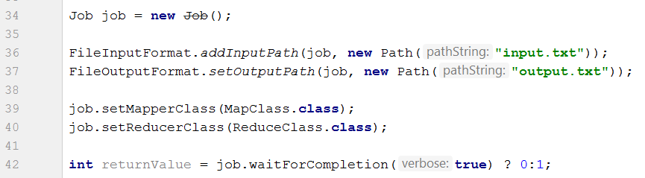
Hadoop Word Count

Slide 10
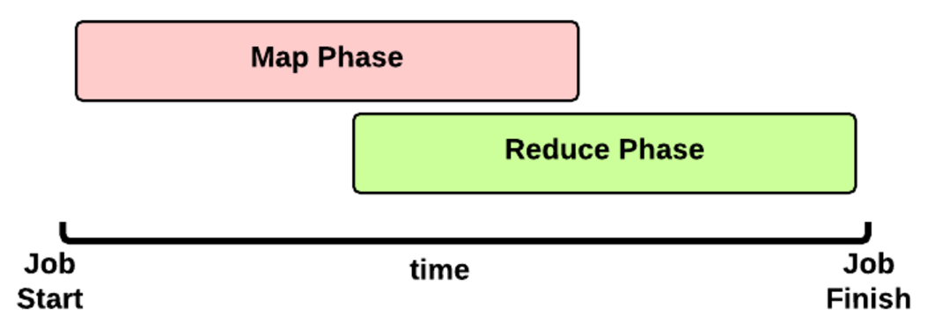
Hadoop Job Internals [1]
Map and reduce is executed by multiple tasks.
One map task is allocated to each input file, a large file can also be split between tasks.
At the end of mapping the <key,value> tuples from each task are packaged ready for the reduce phase.
The reducer combines the multiple outputs into one output file, summing values with the same key.

Slide 11
Hadoop Demo
Hadoop’s MapReduce on a small text file
The text input file is 43 MB of white space separated words
The output will be a list of key-value pairs representative of a word’s number of occurrences

Slide 12
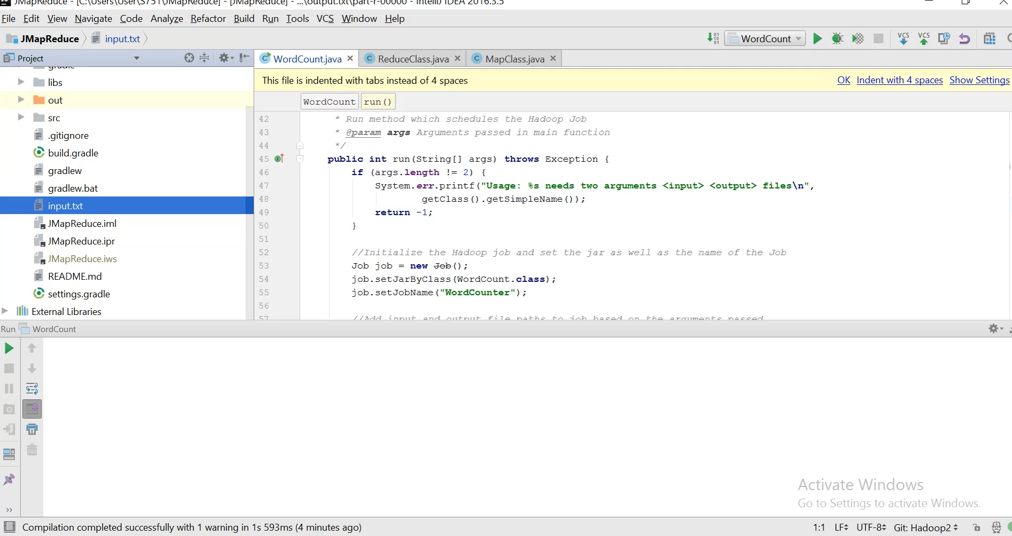

Slide 13
Hadoop, why so slow? [2]
Hadoop is pretty slow on a single computer, why is this?
On a single computer Hadoop runs in pseudo-distributed mode (PDM) in which daemon processes run on multiple cores.
Inter-process communication overhead can be higher with PDM
PDM also increases the time needed to read and write to files.
Hadoop start up overhead is ok for multi-machine large data problems, but on a single computer with modest data the overhead is noticeable.

Slide 14



MapReduce Frameworks
Phoenix MapReduce
Apache Spark
Apache Pig
Hone Architecture

Slide 15
Project goals
In our final project implementation, we aim to build a Map Reduce application optimized for a non-distributed shared memory system.
The application will solve common Map-reduce problems, such as the word count.
The performance can then be compared to existing architectures like Hadoop.

Slide 16
RedLib [3]
RedLib will be used for the reduction stage in our final implementation .
RedLib is a Lightweight Reduction Library for Java, developed at the University of Auckland.
The development of RedLib was motivated to support map-reduce operations in Java, as Java support for reductions is currently limited.
Its goal is to implement a reduction library for shared-memory applications that is as powerful as the frameworks available for distributed-memory applications, such as Hadoop.

Slide 17
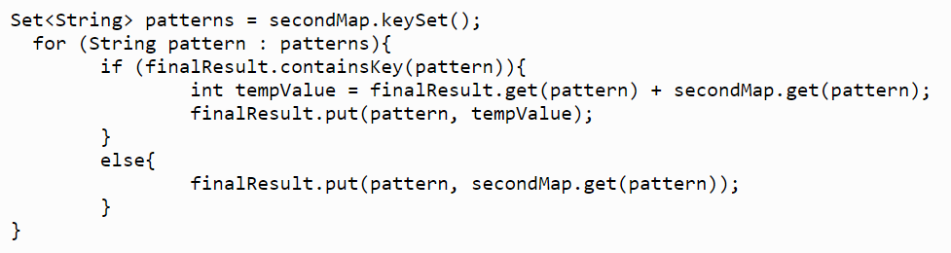
Word Count Example (without RedLib)

Slide 18
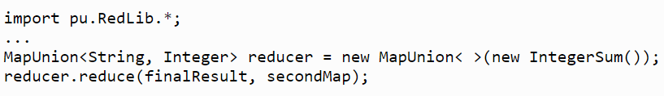
Word Count Example (with RedLib)

Slide 19
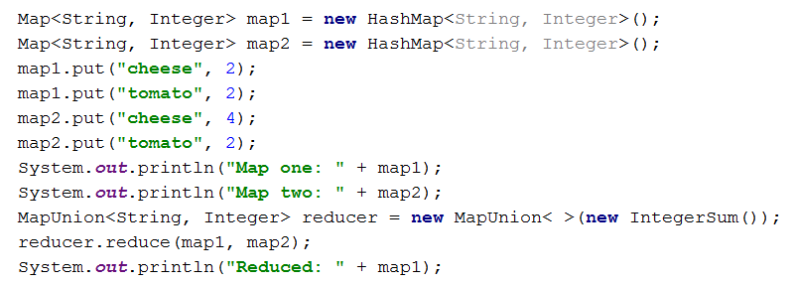
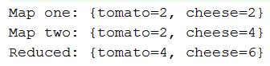
RedLib example

Slide 20
JMapReduce - Mapping Overview
Simple architecture akin to RedLib
Abstraction of parallelism
Mapping interface
Where the user’s mapping logic lies
Mapper object
Where the mapping occurs

Slide 21
JMapReduce - Mapping WordCount
Input is split and passed to threads
Each thread executes the map method
Map method calls each return partial result
Partial results collection reduced

Slide 22
JMapReduce
Demo

Slide 23
Evaluation/Testing methods
Benchmark sequential and parallel versions of our Mapper implementation
Benchmark our parallel implementation against Hadoop on a single shared memory system.

Slide 24
Future work
Parallelise our Mapper implementation
Set up a benchmarking environment
Optimize our implementation by tweaking parallelisation methods

Slide 25
Questions we have answered
Why should we use MapReduce?
What MapReduce is and how it works?
What are some popular implementations of MapReduce?
What will our solution for optimising MapReduce on a shared memory system will look like and what we have running currently?
What work is left to be done?

Slide 26
References
[1]E. Coppa. “Anatomy of a Map Reduce Job” Website. Available: http://ercoppa.github.io/HadoopInternals/AnatomyMapReduceJob.html
[2]K. A. Kumar, J. Gluck, A. Deshpande, J. Lin, “Optimization Techniques for “Scaling Down” Hadoop on Multi-Core, Shared-Memory Systems” University of Maryland USA 2014
[3] M. Mehrabi(2015). RedLib: A Lightweight Reduction Library for Java. Auckland, New Zealand.

